Slide 1
Hibernate Introduction
Hello World and the Hibernate APIs

Slide 2
Hello World I
The Hello World program prints messages
  To demonstrate Hibernate, let’s define a persistent message
  we use a Message persistent class, POJO style
package hello;
public class Message {
private Long id;
private String text;
public String getText() {
return text;
}
public void setText(String text) {
this.text = text;
}
…
}

Slide 3
Hello World II
Messages don't have to be persistent!
  we can use our persistent classes “outside” of Hibernate
  Hibernate is able to “manage” persistent instances
  but POJO persistent classes don't depend on Hibernate
Message message = new Message("Hello World");
System.out.println( message.getText() );

Slide 4
Hello World VI
XML mapping metadata:
<?xml version="1.0"?>
<!DOCTYPE hibernate-mapping PUBLIC
"-//Hibernate/Hibernate Mapping DTD//EN"
"http://hibernate.sf.net/hibernate-mapping-2.0.dtd">
<hibernate-mapping>
<class
name="hello.Message"
table="MESSAGES">
<id>...</id>
<property
name="text"
column="MESSAGE_TEXT"/>
</class>
</hibernate-mapping>

Slide 5
Using C3P0 with hibernate.properties
Let's configure Hibernate to use C3P0 connection pooling
  Hibernate automatically loads hibernate.properties from a root directory of the classpath
hibernate.connection.driver_class = com.mysql.jdbc.Driver
hibernate.connection.url = jdbc:mysql://localhost/helloworld hibernate.connection.username = root
hibernate.connection.password = root
hibernate.dialect = org.hibernate.dialect.mySQLDialect
hibernate.c3p0.min_size = 5
hibernate.c3p0.max_size = 20
hibernate.c3p0.timeout = 1800
hibernate.c3p0.max_statements = 50
Hibernate.c3p0.validate = true
Don't forget to set the SQL dialect!

Slide 6
Starting Hibernate
We create a SessionFactory using a Configuration
  download and install JDBC driver in classpath
  copy Hibernate and the required 3rd party libraries
  chose a JDBC connection pool, customize properties
  add mapping files to the Configuration
  build the SessionFactory (immutable!)
SessionFactory sessionFactory = new Configuration()
.addResource("hello/Message.hbm.xml")
.buildSessionFactory();

Slide 7
Using C3P0 with hibernate.cfg.xml
Let's configure Hibernate to use C3P0 connection pooling
<hibernate-configuration>
<!-- a SessionFactory instance listed as /jndi/name -->
<session-factory>
<!-- properties -->
<property name="dialect">org.hibernate.dialect.MySQLInnoDBDialect</property>
<property name="show_sql">true</property>
<property name="use_outer_join">false</property>
<property name="connection.username">root</property>
<property name="connection.password">root</property>
<property name="connection.driver_class">com.mysql.jdbc.Driver</property>
<property name="connection.url">jdbc:mysql://localhost/helloworld</property>
<!-- mapping files -->
<property name="cache.provider_class"> org.hibernate.cache.NoCacheProvider</property>
<!-- mapping files -->
<mapping resource="hello/Message.hbm.xml"/>
</session-factory>
</hibernate-configuration>

Slide 8
Starting Hibernate
We create a SessionFactory using a Configuration
  download and install JDBC driver in classpath
  copy Hibernate and the required 3rd party libraries
  chose a JDBC connection pool, customize properties
  add mapping files to the Configuration
  build the SessionFactory (immutable!)
SessionFactory sessionFactory = new Configuration()
.configure().buildSessionFactory();

Slide 9
Hello World III
Let's persist a message with Session and Transaction:
Hibernate executes this SQL:
Session session = getSessionFactory().openSession();
Transaction tx = session.beginTransaction();
Message message = new Message("Hello World");
session.save(message);
tx.commit();
session.close();
insert into MESSAGES (MESSAGE_ID, MESSAGE_TEXT)
values (1, 'Hello World')

Slide 10
Hello World IV
Let's show all persistent messages:
Session newSession = getSessionFactory().openSession();
Transaction newTransaction = newSession.beginTransaction();
List messages = newSession.find("from Message");
System.out.println( messages.size() + " message(s) found:" );
for ( Iterator iter = messages.iterator(); iter.hasNext(); ) {
Message message = (Message) iter.next();
System.out.println( message.getText() );
}
newSession.close();
select m.MESSAGE_ID, m.MESSAGE_TEXT from MESSAGES m

Slide 11
Hello World V
Let's update a message:
Session session = getSessionFactory().openSession();
Transaction tx = session.beginTransaction();
// 1 is the generated id of the first message
Message message = session.load( Message.class, new Long(1) );
message.setText("Greetings Earthling");
tx.commit();
session.close();
select m.MESSAGE_TEXT from MESSAGES m where m.MESSAGE_ID = 1
update MESSAGES set MESSAGE_TEXT = ‘Greetings Earthling'
Notice that we did not explicitly call any update() method - automatic dirty checking gives us more flexibility when organizing data access code!

Slide 12
Other configuration options
Instead of using a hibernate.properties file, we may also
  pass an instance of Properties to Configuration programmatically
  set System properties using java -Dproperty=value
  use a hibernate.cfg.xml file in the classpath
The XML-based configuration is almost equivalent to the
properties, it has some more features (cache tuning). The XML file
overrides the hibernate.properties options.
We usually prefer the XML configuration file,
especially in managed environments.

Slide 13
Hibernate Architecture
Hibernate Architecture
Transaction
Query
Application
Session
Session Factory
Configuration
Hibernate.cfg.xml
Hibernate.properties
Mapping files

Slide 14
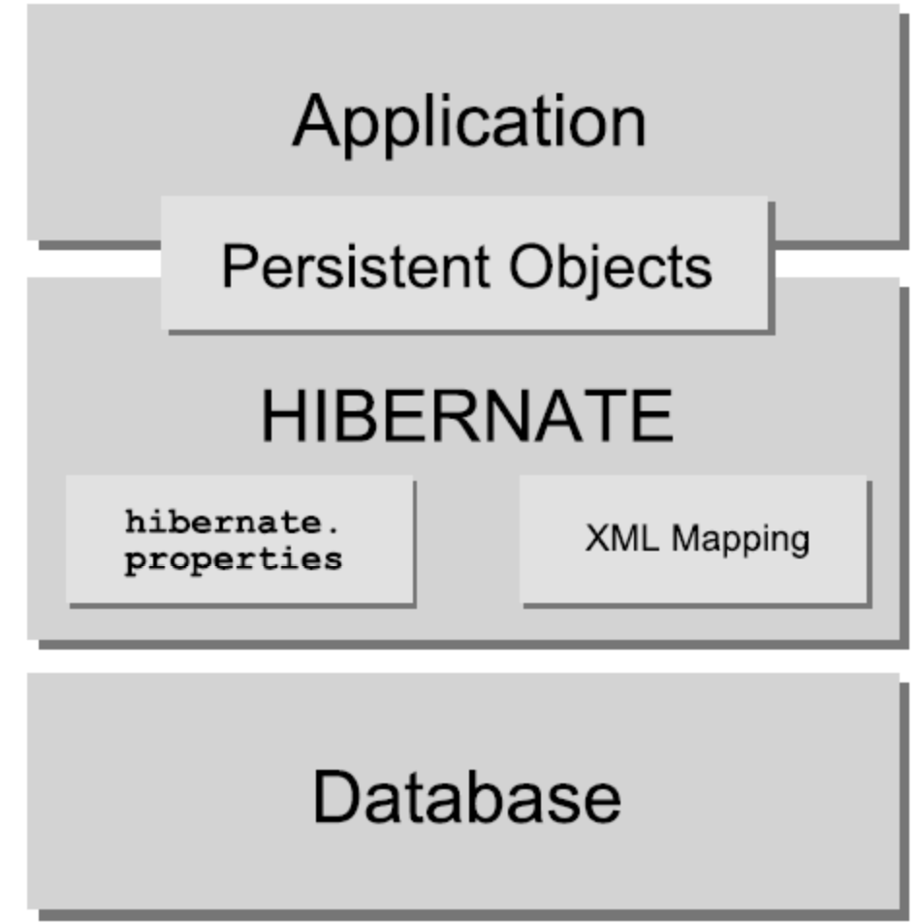
Hibernate Architecture
Hibernate Architecture

Slide 15
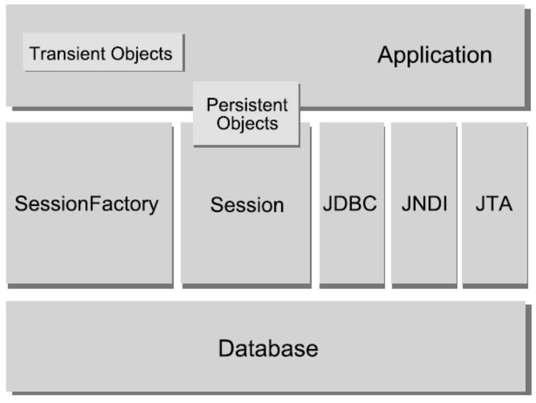
Hibernate Architecture

Slide 16
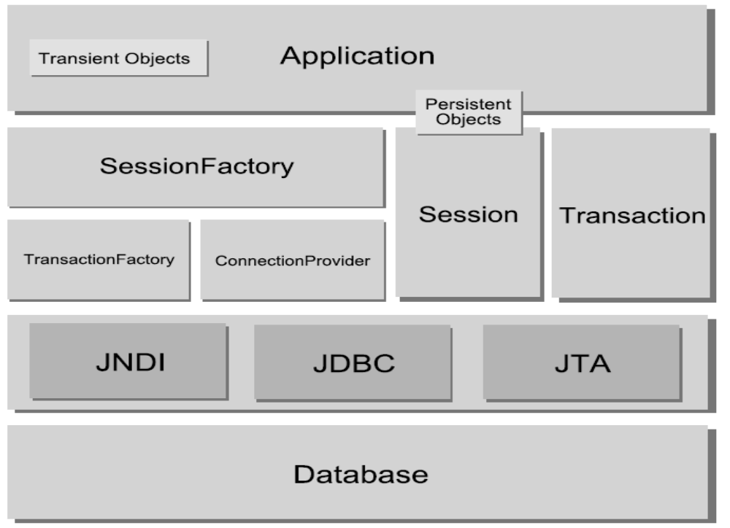
Hibernate Architecture

Slide 17
SessionFactory
SessionFactory (org.hibernate.SessionFactory)
A thread safe (immutable) cache of compiled mappings for a single database. A factory for Session and a client of Connection Provider. Might hold an optional (second-level) cache of data that is reusable between transactions, at a process- or cluster-level.

Slide 18
Session
Session (org.hibernate.Session)
A single-threaded, short-lived object representing a conversation between the application and the persistent store. Wraps a JDBC connection. Factory for Transaction. Holds a mandatory (first-level) cache of persistent
objects, used when navigating the object graph or looking up objects by identifier.

Slide 19
Persistent Objects and Collections
Persistent objects and collections
Short-lived, single threaded objects containing persistent state and business function. These might be ordinary JavaBeans/POJOs, the only special thing about them is that they are currently associated with (exactly one) Session. As soon as the Session is closed, they will be detached and free to use in any application layer (e.g. directly as data transfer objects to and from presentation).

Slide 20
Transient and detached objects and collections
Transient and detached objects and collections
Instances of persistent classes that are not currently associated with a Session. They may have been instantiated by the application and not (yet) persisted or they may have been instantiated by a closed Session.
.

Slide 21
ConnectionProvider
ConnectionProvider
(org.hibernate.connection.ConnectionProvider)
(Optional) A factory for (and pool of) JDBC connections. Abstracts application from underlying Datasource or DriverManager. Not exposed to application, but can be extended/implemented by the developer.

Slide 22
Extension Interfaces
Extension Interfaces
Hibernate offers many optional extension interfaces you can implement to customize the behavior of your persistence layer.(Ex. Primary key generation,SQL Dialet , Caching,JDBC connection, Proxy creationetc.,

Slide 23
Instance States
Instance states
An instance of a persistent classes may be in one of three different states, which are defined with respect to a persistence context.

Slide 24
Instance States
Transient
The instance is not, and has never been associated with any persistence context. It has no persistent identity (primary key value).

Slide 25
Instance States
Persistent
The instance is currently associated with a persistence context. It has a persistent identity (primary key value) and, perhaps, a corresponding row in the database. For a particular persistence context, Hibernate guarantees that persistent identity is equivalent to Java identity (in-memory location of the object).

Slide 26
Instance States
Detached
The instance was once associated with a persistence context, but that context was closed, or the instance was serialized to another process. It has a persistent identity and, perhaps, a corresponding row in the database.
For detached instances, Hibernate makes no guarantees about the relationship between persistent identity and Java identity.

Slide 27
Managed environments
Hibernate can be used in an application server:
Managed environment
Application
Hibernate
Transaction
Manager
EJB
Session
EJB
Transaction
Resource
Manager
EJB
Query
Each database has it's own SessionFactory!

Slide 28
Configuration: “non-managed” environments
In a “non-managed” environment (eg. Tomcat), we need a JDBC connection pool:
  C3P0, Proxool, custom ConnectionProvider
Non-managed environment
Application
Hibernate
JSP
Session
Connection
Pool
Servlet
Transaction
main()
Query

Slide 29
Managed environment with XML configuration file
<hibernate-configuration>
<session-factory name="java:hibernate/SessionFactory">
<property name="show_sql">true</property>
<property name="connection.datasource">
java:/comp/env/jdbc/HelloDB
</property>
<property name="transaction.factory_class">
net.sf.hibernate.transaction.JTATransactionFactory
</property>
<property name="transaction.manager_lookup_class">
net.sf.hibernate.transaction.JBossTransactionManagerLookup
</property>
<property name="dialect">
net.sf.hibernate.dialect.PostgreSQLDialect
</property>
<mapping resource="hello/Message.hbm.xml"/>
</session-factory>
</hibernate-configuration>

Slide 30
Session Cache
To improve the performance within the Hibernate service, as well as your application, is to cache objects.
By caching objects in memory, Hibernate avoids the overhead of retrieving them from the database each time.
Other than saving overhead when retrieving objects, the Session cache also impacts saving and updating objects.
The session interface supports a simple instance cache for each object that is loaded or saved during the lifetime of a given
Session.

Slide 31
Session Cache
Code watch :
Session session = factory.openSession();
Event e = (Event) session.load(Event.class, myEventId);
e.setName(“Hibernate training”);
session.saveOrUpdate(e);
// later, with the same Session instance
Event e = (Event) session.load(Event.class, myEventId);
e.setDuration(180);
session.saveOrUpdate(e);
session.flush();

Slide 32
The Session Cache – Common problem
Don’t associate two instances of the same object with the same Session instance, resulting in a NonUniqueObjectException.
Session session = factory.openSession();
Event firstEvent = (Event) session.load(Event.class, myEventId);
//peform some operation on firstEvent
Event secondEvent = new Event();
secondEvent.setId(myEventId);
Session.save(secondEvent);
This code opens the Session instance, loads an Event instance with a given ID, creates a second Event instance with the same Id, and then attempts to save the second Event instance, resulting in the
NonUniqueObjectException.

Slide 33
The Session Cache – Object Information
To see whether an object is contained in the cache
Session.contains()
Objects can be evicted from the cache by calling
Session.evict()
To clear all the objects from Session cache
Session.clear()

Slide 34
XDoclet
XDoclet is an open source project with an Apache-style license,
Hosted at sourceforge.net.
We can avoid manually writing mapping files.
Add some comments on the .java file and XDoclet will automatically
Generates corresponding .hbm file
XDoclet 1.2.3 support Hibernate 3.x
XDoclet needs to come with new versions whenever Hibernate
Version are changed with new features.

Slide 35
XDoclet @hibernate.class tag
A common @hibernate.class attribute
Attribute : table
Description : contains the name of the table where instances of
this class will be persisted to.
Default : class name

Slide 36
The @hibernate.many-to-one attributes
Attribute | Description | Default
column | Contains the name of the column in the database | The name of the field
Class | Contains the associated persistent class | The class of the field
not-null | Specifies that a not-null constraint should be enforced | False
Unique | Specifies that a unique constraint should be enforced | false
Cascade | Specifies how cascading operations should be handled from parent to child | None. Acceptable values include all, none,save-update or delete

Slide 37
The @hibernate.set tag
Attribute | Description | Default
Cascade | Specifies how cascading operations should be handled from parent to child | None. Acceptable values include all,none,save-update, all-delete-orphan and delete
Table | For the man-to-many association only,contains the association table name for joins | For a many-to-many, it uses the name of the field
Lazy | Specifies whether the collection should be lazily initialized | False
Sort | Specifies whether the collection should be sorted in memory. | Not sorted by default
Order-by | Specifies whether the query to fetch the collection should ad a SQL ORDER BY(asc/desc) | No ORDERBY added
Inverse | Specifies whether the collection is inverse(determines which end of the collection is the parent) | false

Slide 38
Entity Annotations
@Entity
@Table(name=“AUCTION_ITEM”)
public class Item {
private long id;
private String description;
private String productName;
private Set<Bid> bids = new HashSet();
private User seller;
@Id(generate=GeneratorType.AUTO)
@Column(name=“ITEM_ID”)
public long getId() {
return id;
}
public void setId(long id) {
this.id = id;
}
relational table declaration
auto-key generation

Slide 39
Entity Annotations
@Entity
@Table(name=“AUCTION_ITEM”)
public class Item {
private long id;
private String description;
private String productName;
private Set<Bid> bids = new HashSet();
private User seller;
@Id(generate=GeneratorType.AUTO)
@Column(name=“ITEM_ID”)
public long getId() {
return id;
}
public void setId(long id) {
this.id = id;
}
create table AUCTION_ITEM
(
ITEM_ID Number,
DESC varchar(255),
ProductName varchar(255),
USER_ID Number
);

